Slide 1
Reflective Practice in the Workplace

Slide 2

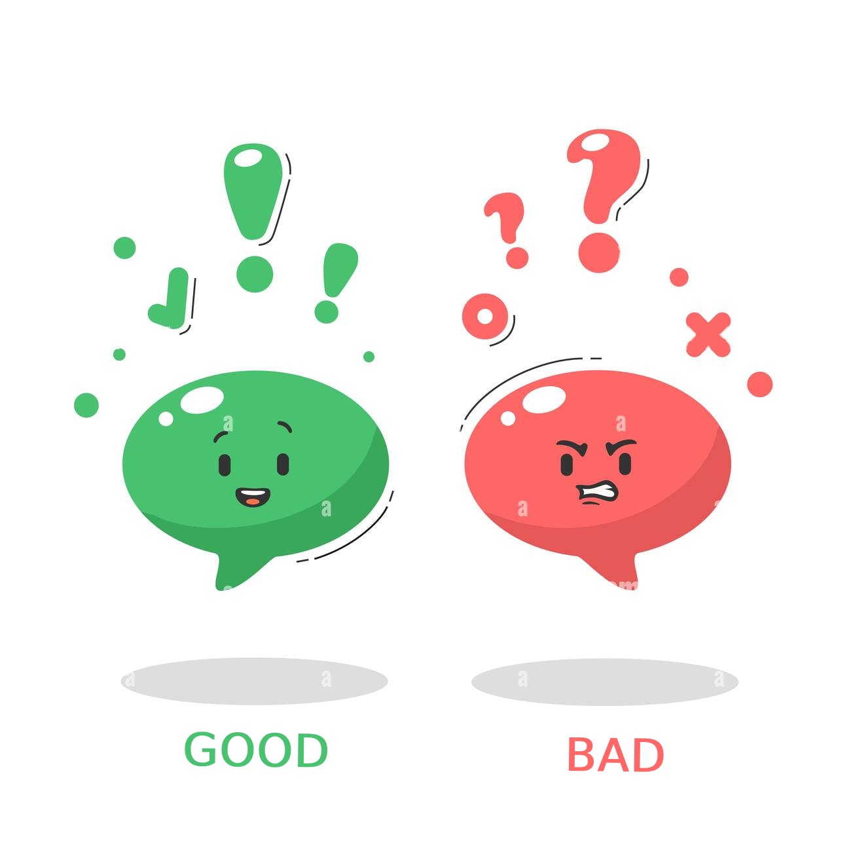
Reflective Practice?
It is the act of thinking about and analyzing our actions and experiences in order to learn from them and improve our performance.
Involves looking back on what happened, examining the situation, and considering what could have been done differently.
Present
Past
And can be done individually or as part of a group, and can be applied to a wide range of professions.

Slide 3

Why is Reflective Practice important?
It allows us to learn from our experiences and mistakes, and to identify areas for improvement.
It can lead to better decision-making and increased self-awareness.
In a business environment, reflective practice can lead to improved customer service and more effective teamwork.

Slide 4

Benefits of Reflective Practice
Improved problem-solving skills
Enhanced learning and personal development
Increased self-awareness and emotional intelligence
Improved communication skills
Increased creativity and innovation

Slide 5

How to do Reflective Practice
There are several methods and templates that can be used for reflective practice, such as Gibbs' Reflective Cycle, Kolb's Learning Cycle, and Borton's Framework.
It's important to choose a method that works best for you or your team.
Steps for reflective practice:
Describe the situation or experience
Analyze the situation and consider what could have been done differently
Evaluate the situation and identify what was learned
Plan for future action

Slide 6

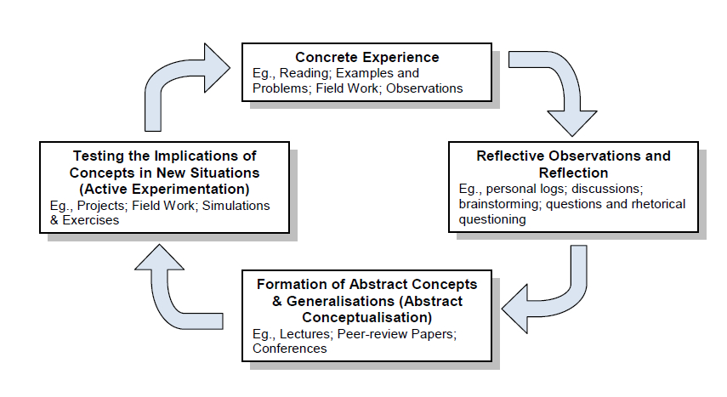

General Reflective Process

Slide 7

Reflective Practice Activity
Gratitude Journal
Get the notebook and set aside a few minutes for this activity.
Write down Five things you are grateful for this week. They can be small things like a good cup of coffee, a kind word from a friend, or a beautiful sunset.
Reflect on why you are grateful for each item on your list. What positive impact did it have on your particular week or your life?
At the end, take a look back at your entries. What patterns or themes emerge? Do you notice any changes in your overall mood or outlook?
This activity can help you cultivate a more positive outlook on life and appreciate the good things, no matter how small, that happen each day. It's also a great way to practice reflection in a short and enjoyable way.

Slide 8
Tips for Effective Reflective Practice
Set dedicated time for reflection
Be open to criticisms and feedback
Practice active listening and empathy
Use a structured reflection method
Reflect regularly, not just after major incidents
Use reflection to inform future action and decision-making

Slide 9
Conclusion
Recap of key points
Reflective Practice, benefits, steps, activity
Emphasis
On the importance of reflective practice for personal and professional growth
R
E
To incorporate reflective practice into daily work routines
Encouragement
Summarize
Conclude
E
C

Slide 10
Thank you!
Any questions?
The floor is open for any questions or comments.

Slide 11
Sources
Boud, D., Keogh, R., & Walker, D. (2013). Reflection: Turning experience into learning. Routledge.
Gibbs, G. (1988). Learning by doing: A guide to teaching and learning methods. Further Education Unit, Oxford Polytechnic.
Kolb, D. A. (1984). Experiential learning: Experience as the source of learning and development. Prentice-Hall.
Schön, D. A. (1983). The reflective practitioner: How professionals think in action. Basic Books.
https://images.app.goo.gl/mYGc9iqmx5U3o86W8. Two cartoon colorful mood smiley bad and good
https://images.app.goo.gl/qqCWa8BR3fZyeCMH6. Reflective Practice in Health Care

Slide 12



Team Presentation
Ujjwal Poudel Centennial College
ID: 301284284
GNED 400001
Kaya Clarke Centennial College
ID: 301339696
GNED 400001
Prajwal Dahal Centennial College
ID: 301298604
GNED 400001

